Slide 1
Yellow Taxi Demand Prediction

Slide 2
90% of the trips are picked up in Manhattan
93% of those trips end in Manhattan
The Manhattan exclusionary zone is reserved for yellow medallion cabs
113M trips in 2017
102M trips started in Manhattan
95M trips started and ended in Manhattan

Slide 3
Direct the destination and route used
Travel to any destination in the five boroughs of the City of New York
Riders can make multiple stops in a single cab ride, though the meter will continue to run throughout the trip and payment will be required at the end of the trip. There is no limit to the number of stops you can request.

Slide 4
Saving Dask dataframe as Parquet improves performance
Eventhough dask can work with minimal RAM. Having more RAM will reduce the number of disk transfers it has to make
If you can load it all in memory pandas is faster
GCP Free Trial
I can access the VM from my local computer through VNC server
Easier to manage files and view dask status and tensor board

Slide 5
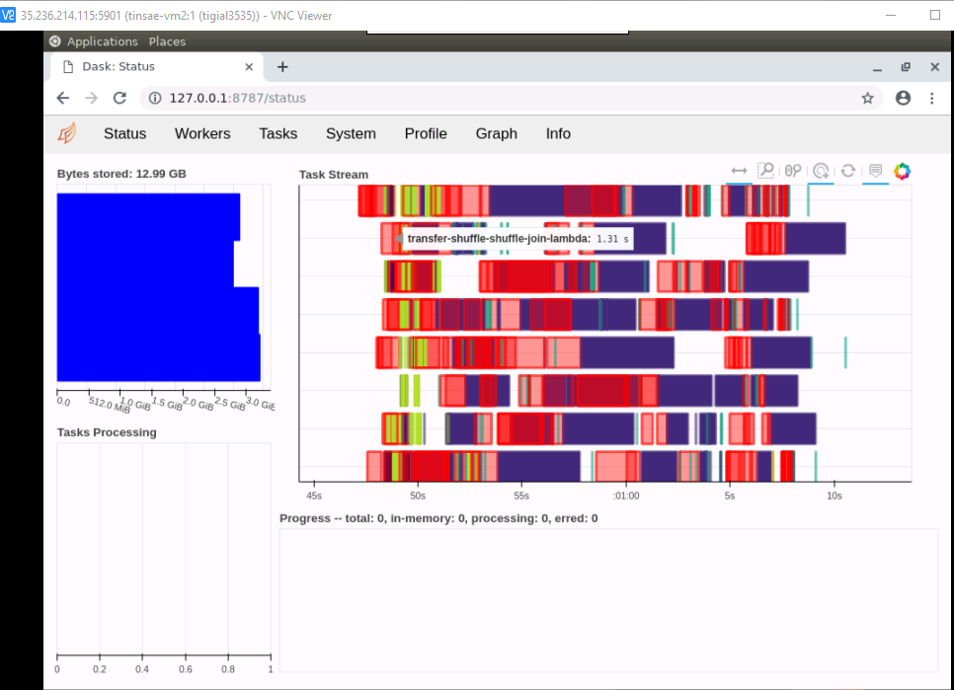

Slide 6
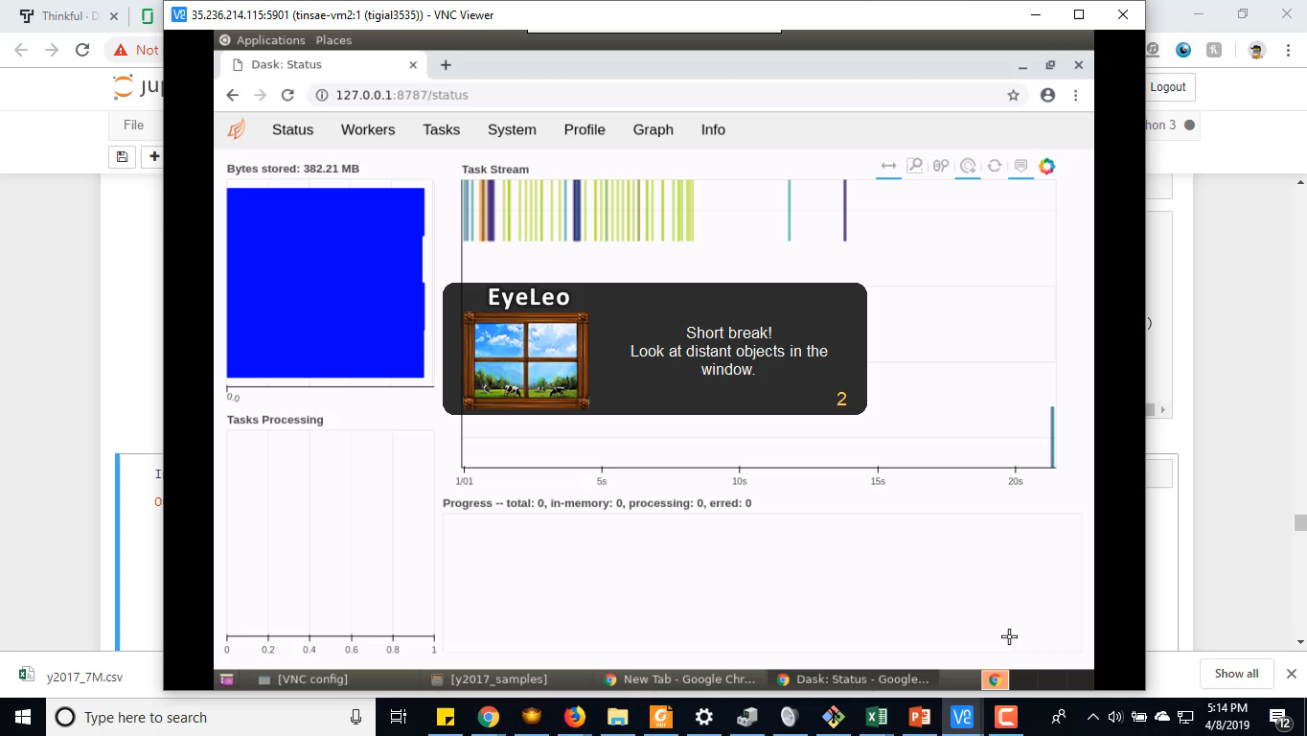

Slide 7
Speed doesn’t include the stops. That is why it is very small
In the top locations there is a trip every 25 seconds at most

